Slide 1
SMARTPREMIUM : PREDICTING INSURANCE COSTS WITH MACHINE LEARNING
DOMAIN – DATA SCIENCE
Presented By
KEERTHANA A

Slide 2
WORK FLOW
Raw Data
↓
Data Cleaning
↓
Exploratory Data Analysis (EDA)
↓
Feature Engineering
↓
Model Training
↓
Model Evaluation
↓
Deployment (Streamlit)

Slide 3
SUMMARY OF THE DATASET
Column | Non-Null Count | Meaning
Age, Gender, Education Level, Location, Policy Type, Smoking Status, Exercise Frequency, Property Type | 1,200,000 non-null | ✅ Complete categorical & demographic information
Annual Income | 1,155,051 non-null | ⚠️ Missing values present
Number of Dependents | 1,090,328 non-null | ⚠️ Missing values present
Occupation | 841,925 non-null | ⚠️ High missing values
Health Score | 1,125,924 non-null | ⚠️ Missing values present
Previous Claims | 835,971 non-null | ⚠️ Missing values present
Credit Score | 1,062,118 non-null | ⚠️ Missing values present
Policy Start Date | dtype: object | 📅 Date stored as string
Premium Amount | dtype: float64 | ✅ Target variable for prediction
• Dataset contains 1.2 million records with 21 features • Missing values handled during data cleaning & preprocessing • Target variable: Premium Amount

Slide 4
FEATURES CREATED
Feature | Description
Age | Numerical feature (missing values handled)
Annual Income | Income indicator (missing values handled)
Number of Dependents | Numerical feature
Health Score | Health risk indicator
Previous Claims | Claim history feature
Vehicle Age | Age of vehicle
Credit Score | Financial reliability indicator
Insurance Duration | Policy duration
Policy Start Date | Year & Month extracted
Categorical Features | Encoded (Gender, Occupation, Location, Policy Type, etc.)
Premium Amount | 🎯 Target variable

Slide 5
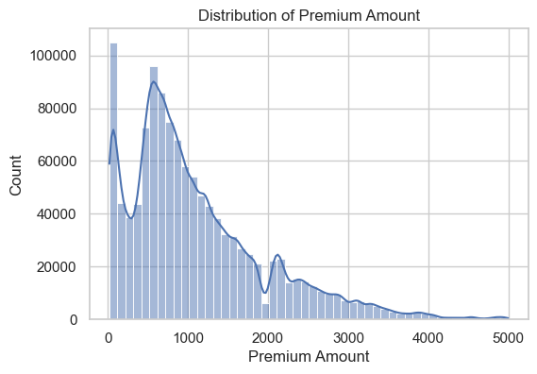
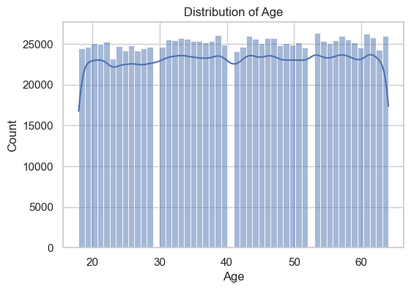
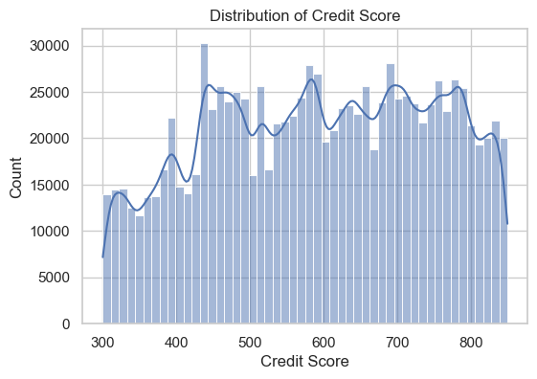
UNIVARIATE – NUMERICAL
Premium Amount is right-skewed with outliers.
Age is uniformly distributed.
Credit Score is evenly spread across customers.
Overall Insight:
Numerical features show reasonable distributions with skewness and
outliers present in Premium Amount, which were handled during preprocessing.

Slide 6
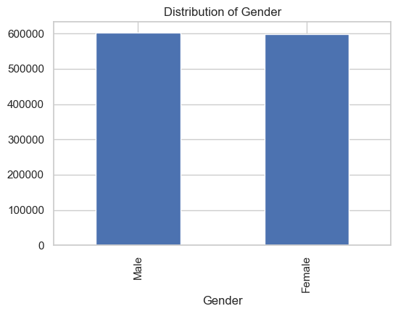
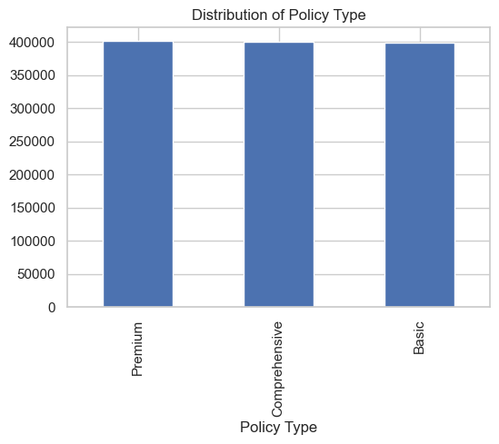
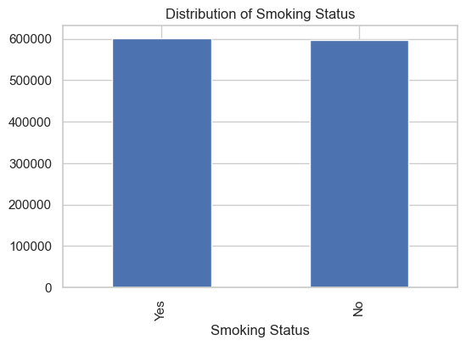
UNIVARIATE – CATEGORICAL
Gender distribution is almost balanced
Policy types are evenly distributed
Smoking status shows no major class imbalance
Categorical features are suitable for encoding
Overall Insight:
Categorical features are well balanced with no significant class imbalance,
ensuring unbiased model training.

Slide 7
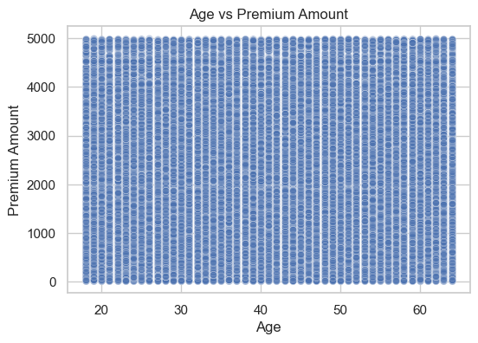
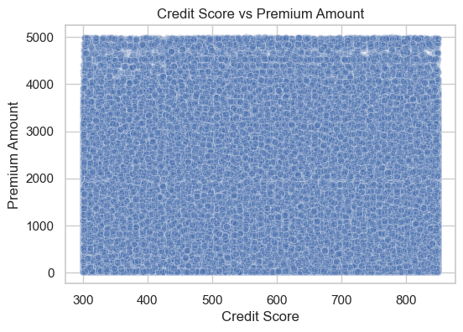
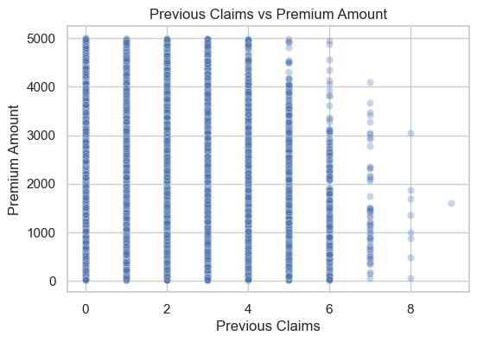
BIVARIATE – NUMERICAL vs TARGET
Weak relationship between age and premium
Credit score shows no strong linear trend
Premium varies with number of previous claims
Overall Insight:
Among numerical variables, Previous Claims has the strongest relationship with Premium Amount,
while Age and Credit Score show minimal impact.

Slide 8
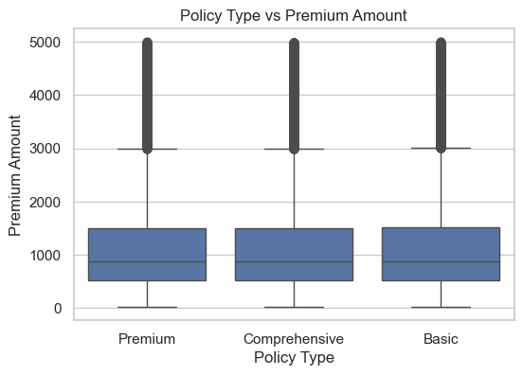
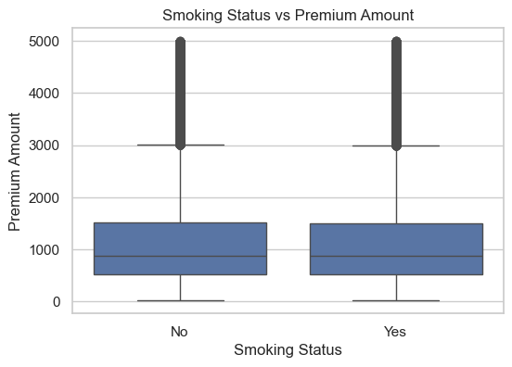
BIVARIATE – CATEGORICAL vs TARGET
Premium amount varies across different policy types”
Smokers generally show higher premium variability
Presence of outliers indicates high-risk customers”

Slide 9
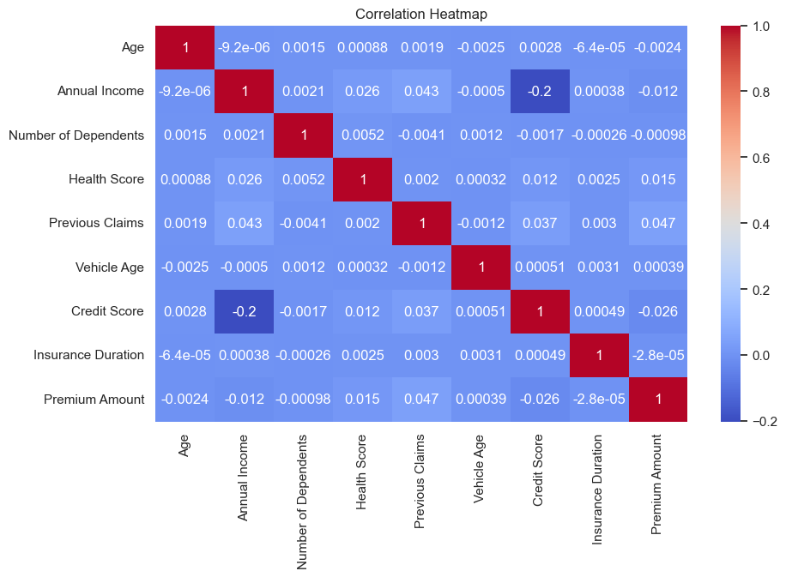
MULTIVARIATE ANALYSIS – CORELATION HEATMAP OF NUMERIC FEATURES
Shows correlation between numerical variables
Most features have low to moderate correlation
Previous Claims shows noticeable correlation with Premium Amount
No strong multicollinearity observed

Slide 10
DATA PREPOSSING & FEATURE ENGINEERING
Missing values handled using Median (Numerical) and Mode (Categorical)
Categorical variables encoded using Label Encoding (tree-based compatible)
Date feature transformed into numeric timestamp
Dataset split into Training (80%) and Testing (20%)
Numerical features standardized using StandardScaler
Preprocessing pipeline saved to ensure consistent deployment

Slide 11
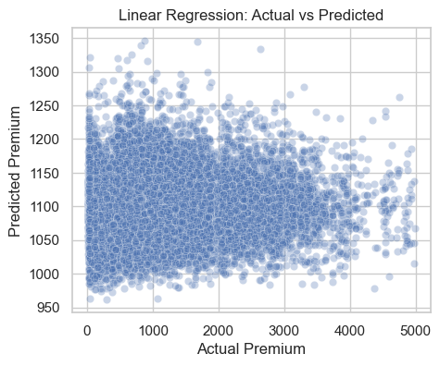
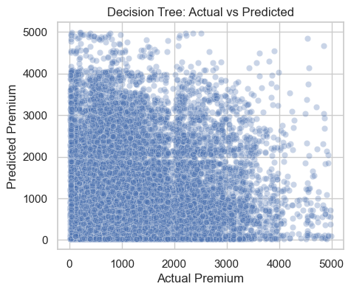
MODEL COMPARSION – ACTUAL VS PREDICTED PREMIUM
Model | MAE | RMSE | R²
Linear Regression | 665.57 | 865.14 | 0.00
Decision Tree | 902.75 | 1239.95 | -1.05
Linear Regression shows high error and near-zero R²
Decision Tree shows negative R² (overfitting)
Actual vs Predicted plots show large deviations
Overall performance is limited due to
weak feature–target relationship

Slide 12
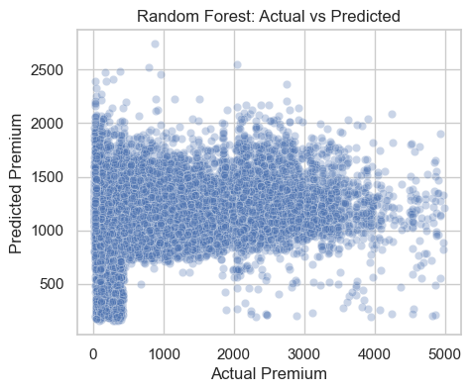
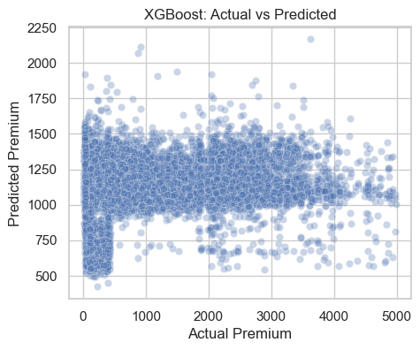
MODEL COMPARSION – ACTUAL VS PREDICTED PREMIUM
Model | MAE | RMSE | R²
Random Tree | 664.23 | 867.90 | -0.00
XGBoost | 648.07 | 850.65 | 0.04
Random Forest improves error compared to Decision Tree
XGBoost achieves the lowest MAE and RMSE
XGBoost shows the best R² score among all models
Overall prediction accuracy is still limited

Slide 13
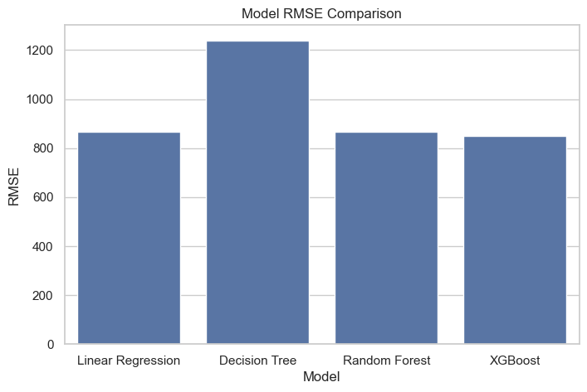
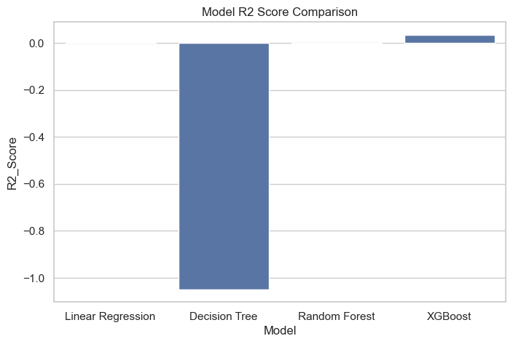
MODEL COMPARSION
Model | MAE | RMSE | R2_Score
Linear Regression | 665.571787 | 865.137766 | 0.002481
Decision Tree | 902.746650 | 1239.946497 | -1.049069
Random Forest | 664.232369 | 867.898382 | -0.003895
XGBoost | 648.070613 | 850.647416 | 0.035616

Slide 14
MODEL PERFORMANCE(XGBOOST PIPELINE)
Metric | Value
MAE | 647.51
RMSE | 847.54
R² Score | 0.04
PIPELINE SAVING & MODEL DEPLOYMENT
Trained ML pipeline saved using Joblib
Includes preprocessing + XGBoost model
Ready for future predictions & deployment
File: smartpremium_pipeline.pkl

Slide 15
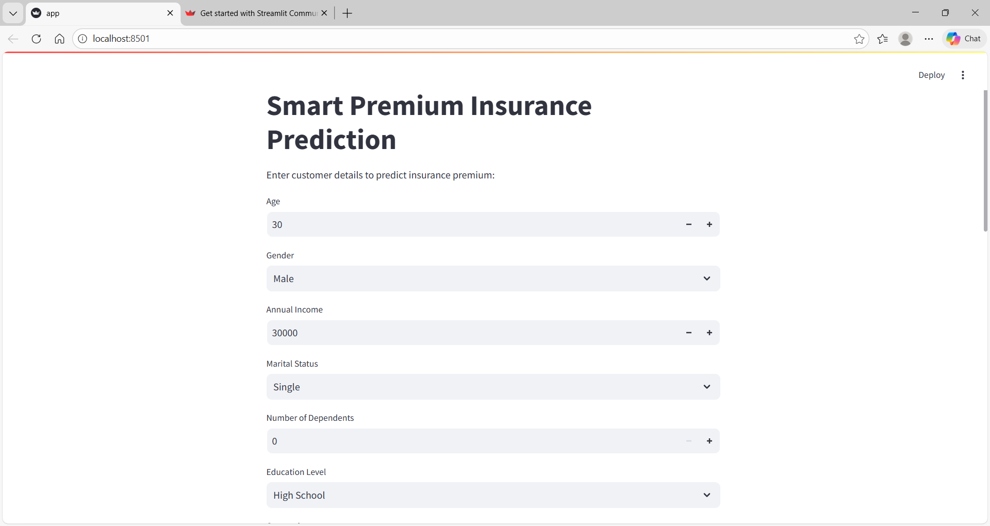
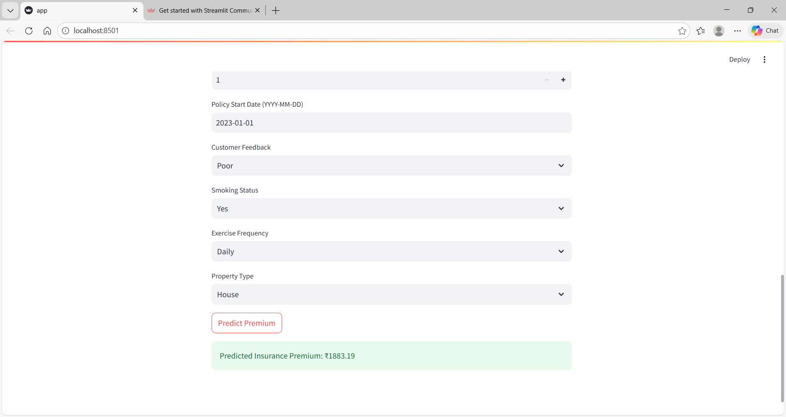
MODEL DEPLOYMENT USING STREAMLIT
REAL STREAMLIT UI SCREENSHOT
Model deployed using Streamlit
Interactive UI for entering customer details
Real-time insurance premium prediction
End-to-end ML pipeline integrated
Application running on http://localhost:8501

Slide 16
CONCLUSION
End-to-end ML-based insurance premium prediction system implemented
Integrated data preprocessing, XGBoost pipeline, and Streamlit UI
Enables real-time and automated premium estimation
Scalable solution with scope for further improvements

